Slide 1
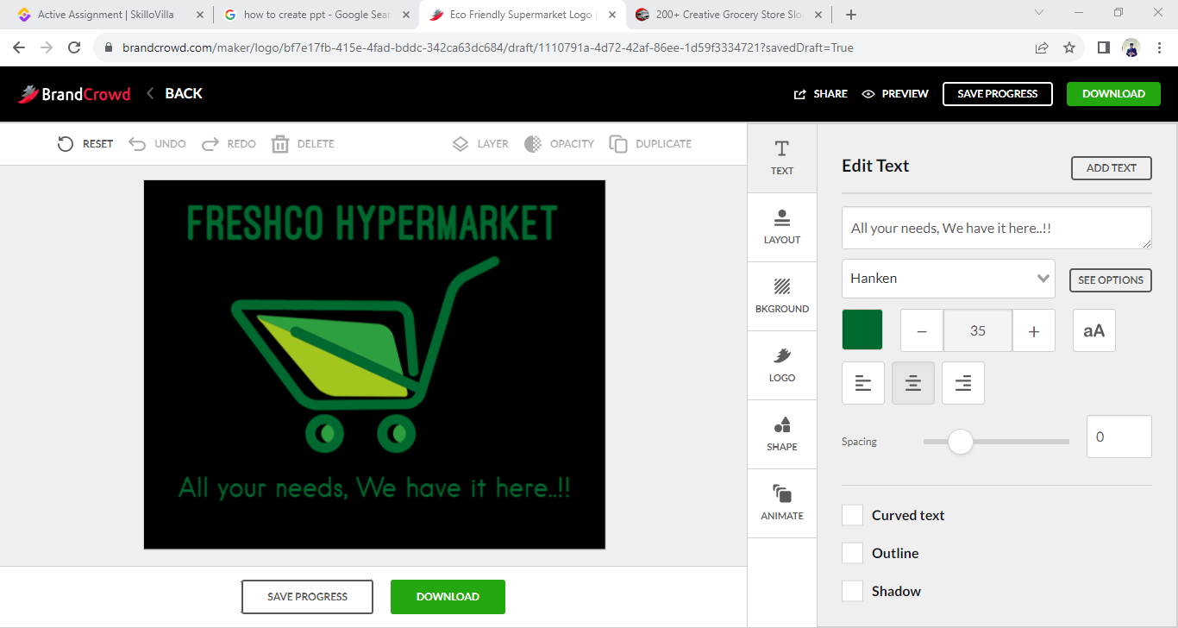
Freshco Hpermarket
Freshco Hypermarket, situated in HSR, Bangalore, has established itself as a prominent supermarket in the region, catering to a wide range of customers. In response to evolving customer needs and to enhance convenience, Freshco introduced a home delivery service in the year 2021.

Slide 2
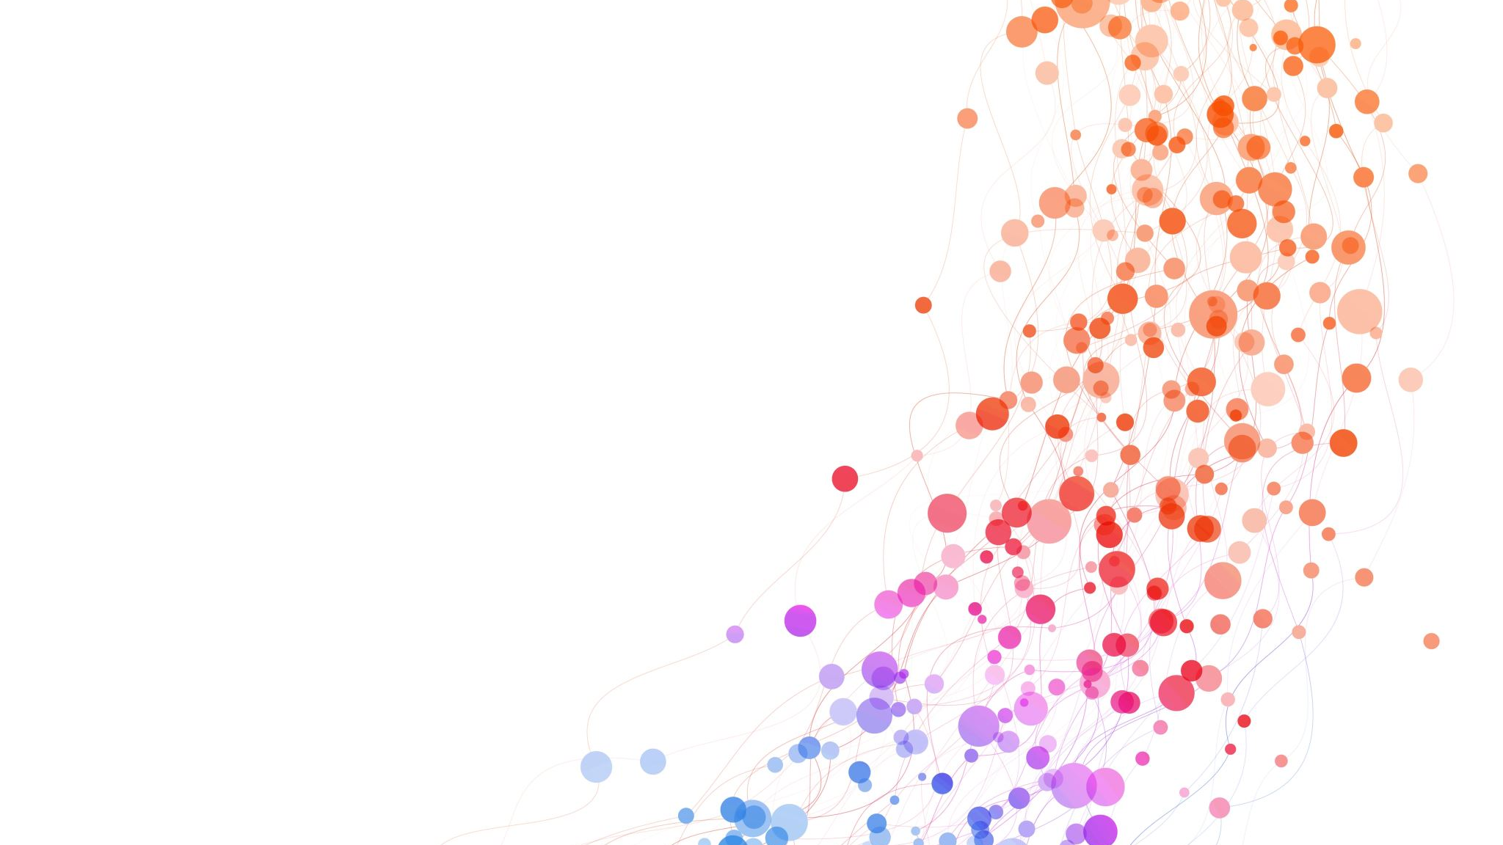
Freshco Hypermarket
Order Analysis Completion rate Analysis
Customer Analysis Delivery Analysis

Slide 3
Order Analysis

Slide 4
Order Level Analysis
The delivery charges are high during late night as compared to other orders during morning, afternoon, evening and night.
Dsicount offered to customers at late night is low as compared to those of at morning , afternoon, evening and night,

Slide 5
Summary
In Order analysis we have found from the given data that the order were mostly placed from HSR Layout and ITI Layout which is 86% of total order placed . Although this orders were placed during different times of day, but mostly they were placed during afternoon ,morning and night. Orders placed during afternoon , morning , evening , and night were having a great discount and less delivery charges as compared to those of during late night.

Slide 6
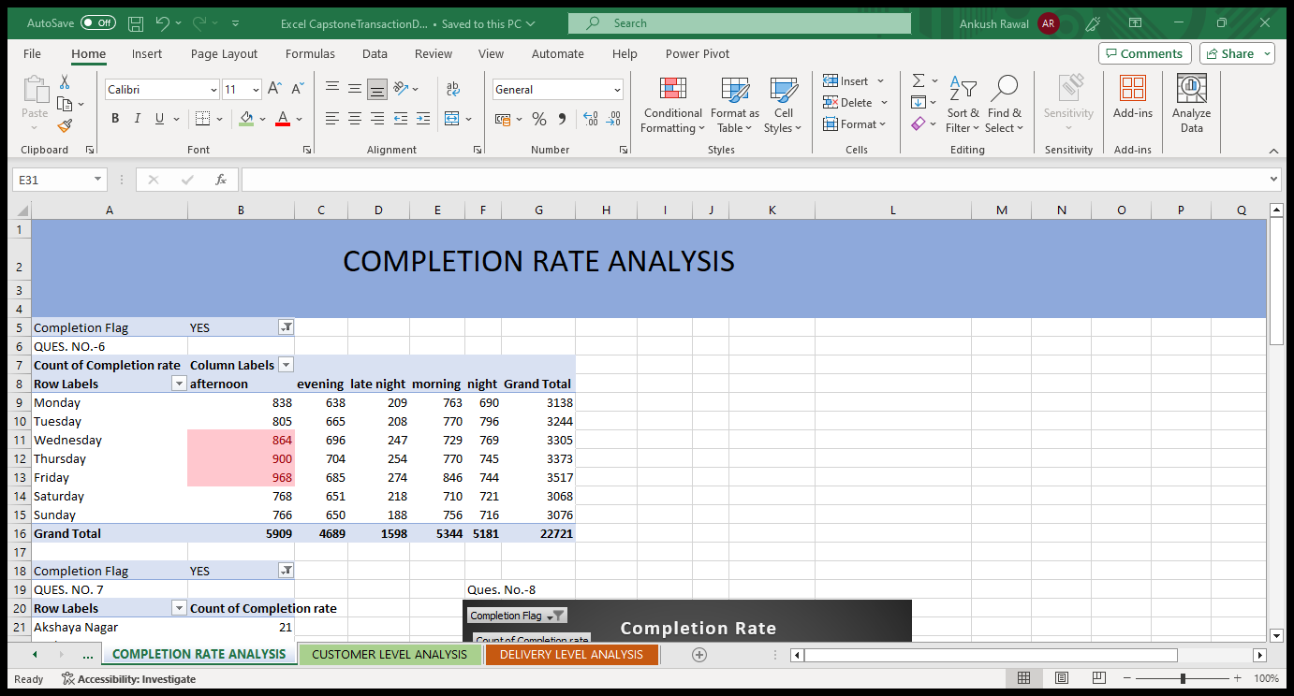
Completion Rate Analysis

Slide 7
Summary
In Completion Rate Analysis we have found that ordered placed in afternoon on weekdays such as Wednesday ,Thursday and Friday were in huge numbers and were completed by time. As we know freshco hyperamrekt is situated in HSR layout , the order completion rate was high over there as compared from others. One of the main reason for the order completion was also the no. of products been order for a particular order as the no. of products increases the completion rate decreases . Most of the order that were completed were having a less no. of products . Hence it was easy to delivered this products from store to nearby drop location.

Slide 8
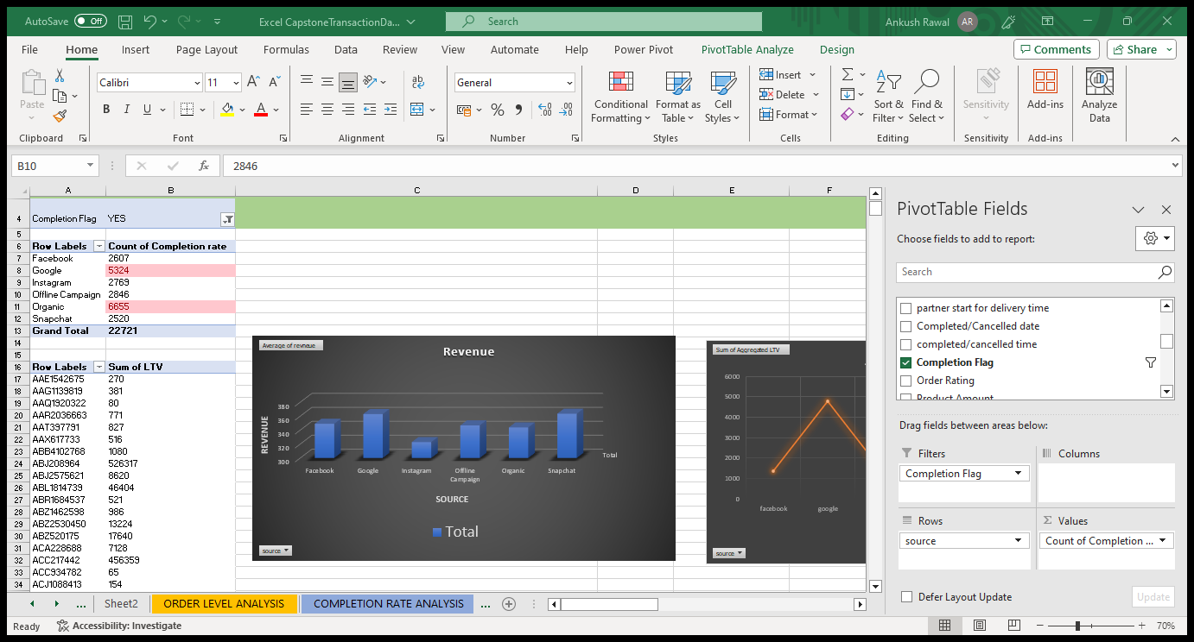
Customer Level Analysis
Customers were gained from different platform like Facebook, Google, Instagram, Organic, Snapchat and Offline campaign. Completion rate of Google and Organic are too high among all other sources.

Slide 9
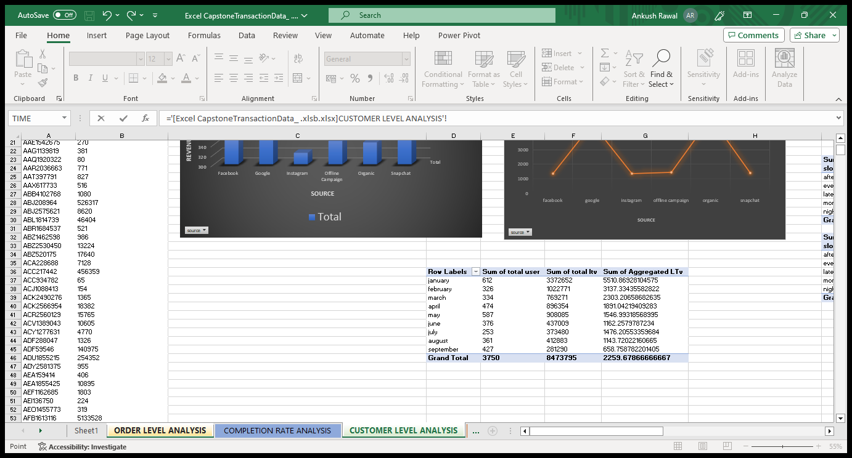
Customer Level Analysis
The Aggregated LTV is (sum of total LTV / sum of total user) during a particular period of time. Here we have shown Aggregated LTV generated around months. Hence it is cleared that january month has highest Aggreagated LTV among other.

Slide 10
Customer Level Analysis

Slide 11
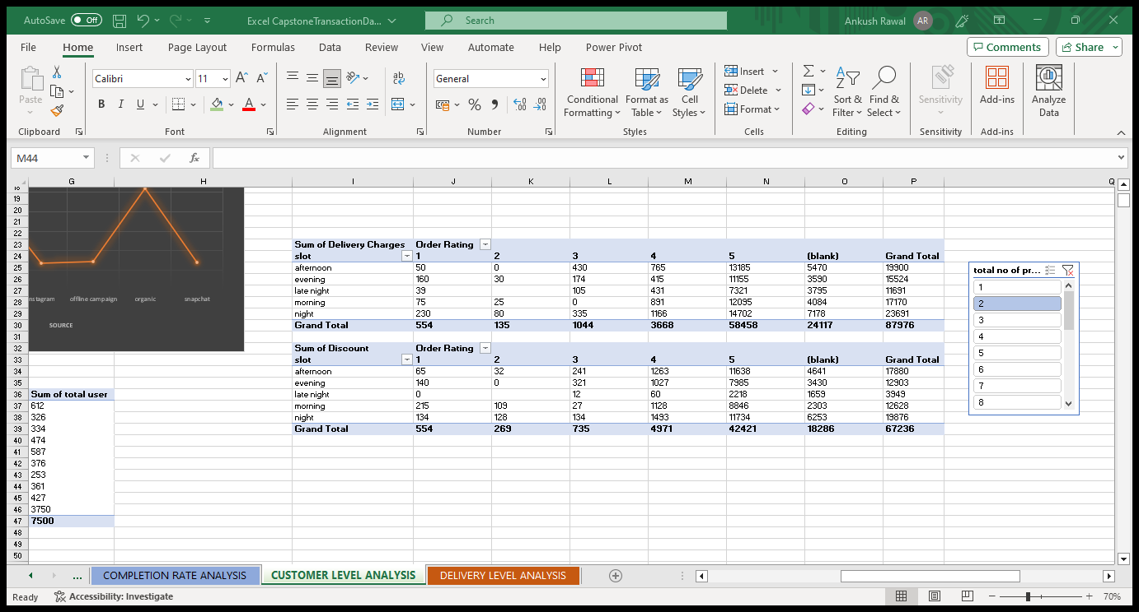
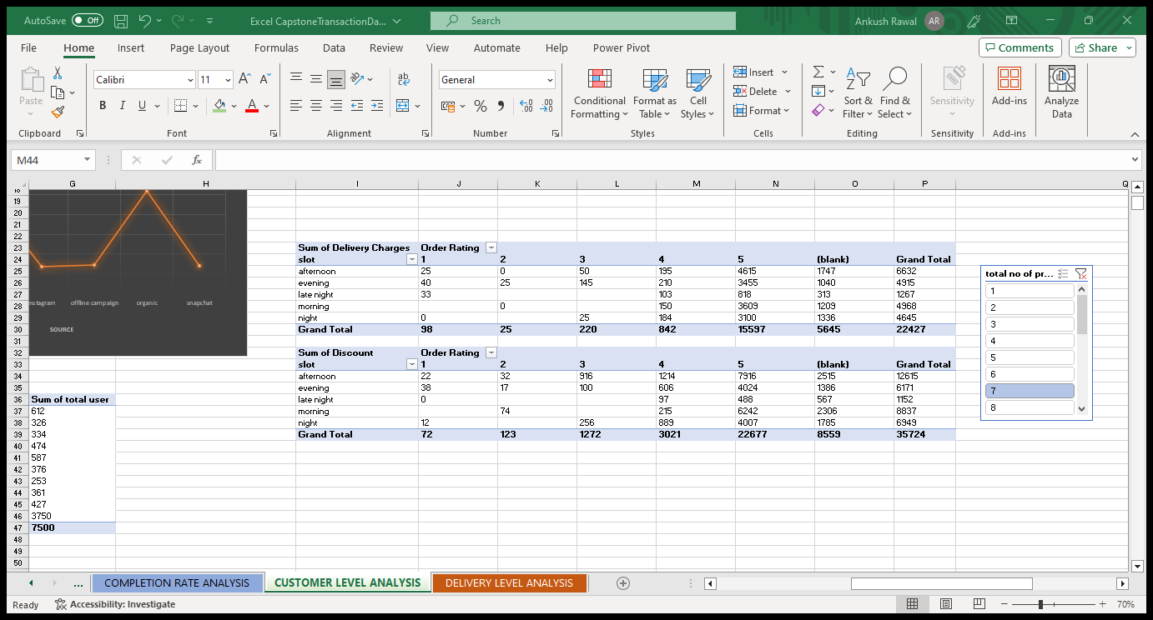
Customer Level Analysis
Here it is clear that as the number of the product is less the delivery charges and discount rate increased and as the number of product is more the delivery charges and discount rate decreases. The products having order rating of 4and 5 have higher delivery charge and discount as compared to those of product having order rating of 1,2 and3.
1.The number of products being ordered is 2.
2.The no. of product being ordered is 7.

Slide 12
Summary
In customer level analysis, we have analyzed that the customers for freshco hypermarket were gained from Google, Instagram, Facebook, Snapchat, Organic and Offline campaign through their advertising on this platform, and most of the customers joined from Google and Organic. Google and Organic have been among top sources in terms of generating revenue for the business and the customer LTV of the sources are also too high on being compared to others. Completion rate is proportional to total no. of products being ordered , if no. of products is higher than completion rate is lower, and vice-versa. Order ratings of 4 and 5 having 1, 2 and 3 as total no. of products have high delivery charge. Order ratings of 4 and 5 having 2, 3 and 4 as total no. of products have high discount. As the no. of product increases the delivery charges and discount decreases. The Aggregated LTV (Sum of total LTV/sum of total user) is high in the month of January as compared to others.

Slide 13
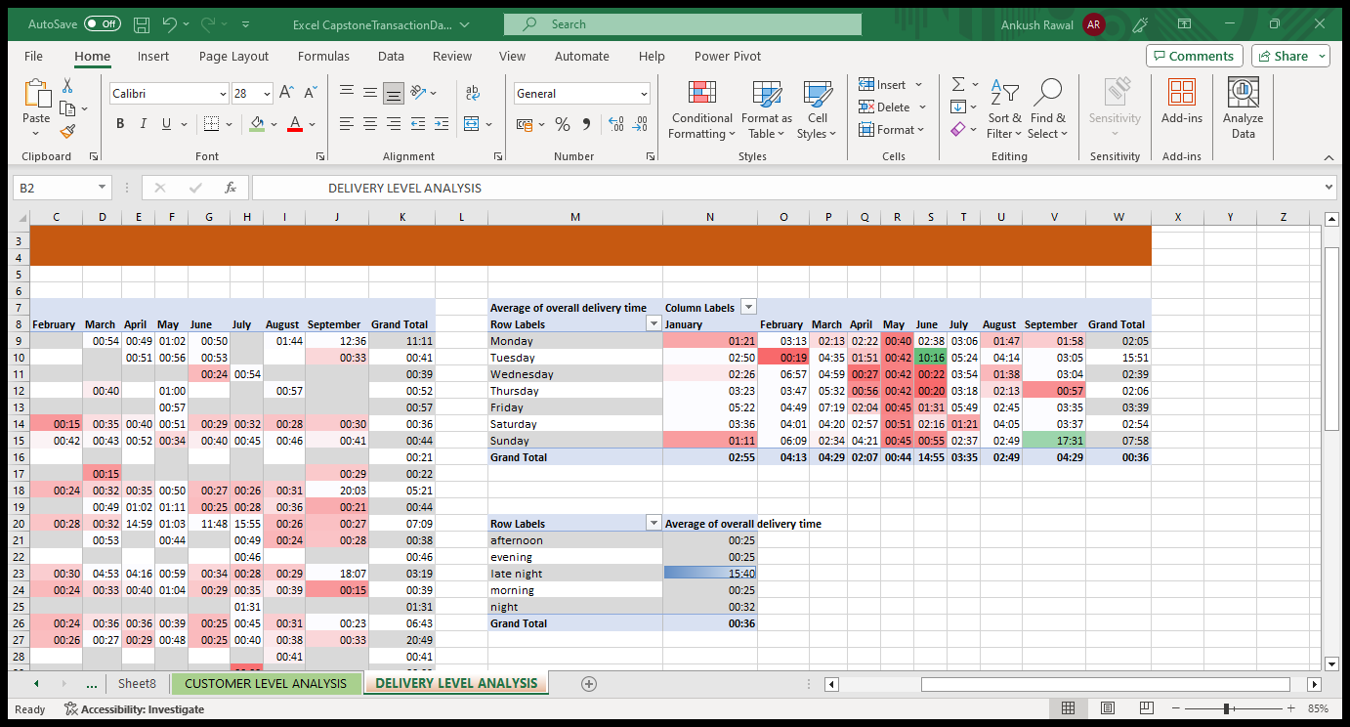
Delivery Level Analysis

Slide 14
Summary
In Delivery Level Analysis we have noticed that the average overall delivery time of late night is high among others. In the months of June and September the average overall delivery time is high due to large no. of orders been placed in this months. Another thing to be noticed is that on weekend especially Sunday the overall delivery time is high among the other rest of days. Kudlu has the highest overall delivery time among all other delivery areas, where as area like cox town and whitefield have low average of overall delivery time.

